Slide 1

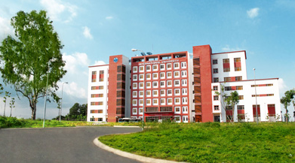
International University
MICRO-PROCESSING SYSTEM
Lecture 9B:
AVR UART Serial Port Programming in Assembly and C
Vo Minh Thanh, M.Eng
School Of Electrical Engineering

Slide 2
Serial Port Registers
In the AVR microcontroller five registers are associated with the USART. They are
UBRR (USART Baud Rate Register)
UDR (USART Data Register)
UCSRA (USART Control and Status Register A)
UCSRB (USART Control and Status Register B)
UCSRC (USART Control and Status Register C)
UBRR (12-bit USART Baud Rate Register)
The USART Baud Rate Register (UBRR) is 12-bit (0-4095) register. This register is used to set baud rate of USART.
UDR (8-bit USART Data Register)
UDR is used to send or receive data.

Slide 3
UBRR (USART Baud Rate Register)
For a given crystal frequency, the value loaded into the UBRR decides the baud rate.
Two 8-bit registers together define the baud rate.

Slide 4
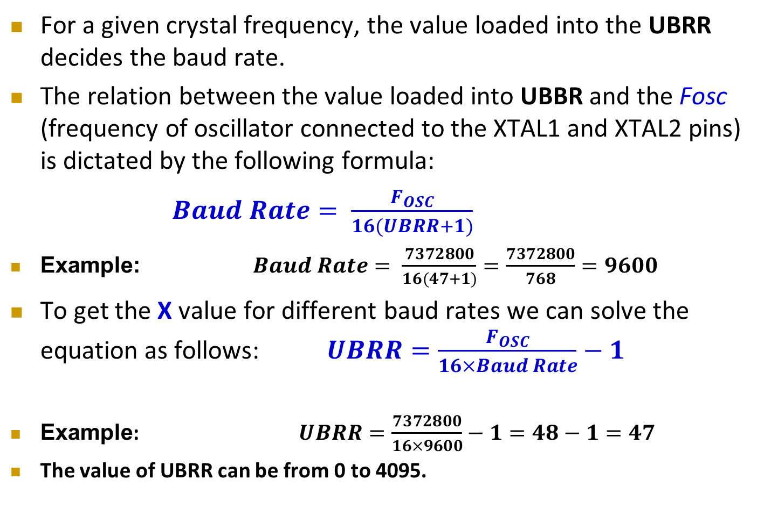
UBRR (USART Baud Rate Register)
For a given crystal frequency, the value loaded into the UBRR decides the baud rate.
The relation between the value loaded into UBBR and the Fosc (frequency of oscillator connected to the XTAL1 and XTAL2 pins) is dictated by the following formula:
$Baud Rate= \frac{F_{OSC}}{16(UBRR+1)}$
Example: $Baud Rate= \frac{7372800}{16(47+1)}=\frac{7372800}{768}=9600$
To get the X value for different baud rates we can solve the equation as follows: $UBRR=\frac{F_{OSC}}{16×Baud Rate}−1$
Example: $UBRR=\frac{7372800}{16×9600}−1=48−1=47$
The value of UBRR can be from 0 to 4095.
For U2X = 1
Replace 16 with 8

Slide 5
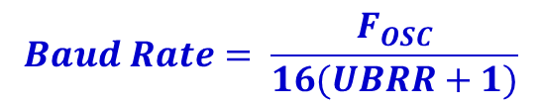
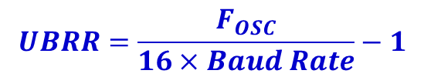
Different Values of UBRR
Fosc = | 1.000000 | MHz = | 1000000 | Hz |  | Decimal to Hexadecimal Conversion
Baud Rate (bps) | U2X = 0 |  | U2X = 1 |  |  | In DEC = | 254 |  | FE | In HEX
 | UBRR | % Error | UBRR | % Error
110 | 567.18 | 0.03 | 1135.36 | 0.03
300 | 207.33 | 0.16 | 415.67 | 0.16 |  | Hexadecimal to Decimal Conversion
1,200 | 51.08 | 0.16 | 103.17 | 0.16 |  | In HEX = | FE |  | 254 |  | In DEC
2,400 | 25.04 | 0.17 | 51.08 | 0.16
4,800 | 12.02 | 0.17 | 25.04 | 0.17
9,600 | 5.51 | 10.21 | 12.02 | 0.17 |  | Value of UBRR = |  |  | 12
19,200 | 2.26 | 12.76 | 5.51 | 10.21 |  | For U2X = 0 Baud Rate= |  |  | 4,807.69
38,400 | Out of Range |  | 2.26 | 12.76 |  | For U2X = 1 Baud Rate= |  |  | 9,615.38
57,600 | Out of Range |  | 1.17 | 17.01
115,200 | Out of Range |  | Out of Range
$$UBRR=\frac{F_{OSC}}{16×Baud Rate}−1$$
$$Baud Rate= \frac{F_{OSC}}{16(UBRR+1)}$$

Slide 6
UCSRA (USART Control and Status Register A)
Bit No. |  | D7 |  | D6 |  | D5 |  | D4 |  | D3 |  | D2 |  | D1 |  | D0 |  |  |  | Register Value
Bit Name |  | RXC |  | TXC |  | UDRE |  | FE |  | DOR |  | PE |  | U2X |  | MPCM |  |  |  | In DEC |  | In HEX
Value |  | 0 |  | 0 |  | 0 |  | 0 |  | 0 |  | 0 |  | 0 |  | 0 |  |  |  | 00 |  | 00
RXC |  | D7 | USART Receive Complete |  |  |  |  |  |  |  |  |  |  |  | TXC |  | D6 | USART Transmit Complete
 |  | 0 | Receive buffer is empty |  |  |  |  |  |  |  |  |  |  |  |  |  | 0 | Receive buffer is empty so transmit complete interrupt is executed
 |  | 1 | There is new data in the receive buffer |  |  |  |  |  |  |  |  |  |  |  |  |  | 1 | Entire frame in the transmit shift register has been transmitted
UDRE |  | D5 | USART Data Register Empty |  |  |  |  |  |  |  |  |  |  |  | FE |  | D4 | Frame Error
 |  | 0 | Wait, do not write to UDR |  |  |  |  |  |  |  |  |  |  |  |  |  | 0 | No frame error
 |  | 1 | Tramsmit data buffer is empty |  |  |  |  |  |  |  |  |  |  |  |  |  | 1 | Frame error has occurred
DOR |  | D3 | Data Over Run |  |  |  |  |  |  |  |  |  |  |  | PE |  | D2 | Parity Error
 |  | 0 | No Data Over Run |  |  |  |  |  |  |  |  |  |  |  |  |  | 0 | No Paroty Error
 |  | 1 | Data over run is detected |  |  |  |  |  |  |  |  |  |  |  |  |  | 1 | Parity Error is detected
U2X |  | D1 | Double the USART Transmission Speed |  |  |  |  |  |  |  |  |  |  |  | MPCM |  | D0 | Multi-processor Communication Mode
 |  | 0 | Single Baud Rate |  |  |  |  |  |  |  |  |  |  |  |  |  | 0 | Disable Multi-processor Communication Mode
 |  | 1 | Double Date Transfer rate for Asynchronous Communication |  |  |  |  |  |  |  |  |  |  |  |  |  | 1 | Enable Multi-processor Communication Mode
UCSRA (USART Control and Status Register A)

Slide 7
UCSRB (USART Control and Status Register B)
Bit No. |  | D7 |  | D6 |  | D5 |  | D4 |  | D3 |  | D2 |  | D1 |  | D0 |  |  |  | Register Value
Bit Name |  | RXCIE |  | TXCIE |  | UDRIE |  | RXEN |  | TXEN |  | UCSZ2 |  | RXB8 |  | TXB8 |  |  |  | In DEC |  | In HEX
Value |  | 0 |  | 0 |  | 0 |  | 1 |  | 1 |  | 0 |  | 0 |  | 0 |  |  |  | 24 |  | 18
RXCIE |  | D7 | Receive Complete Interrupt Enable |  |  |  |  |  |  |  |  |  |  |  | TXCIE |  | D6 | Transmit Complete Interrupt Enable
 |  | 0 | This Interrupt is disabled |  |  |  |  |  |  |  |  |  |  |  |  |  | 0 | This Interrupt is disabled
 |  | 1 | This interrupt is enabled |  |  |  |  |  |  |  |  |  |  |  |  |  | 1 | This interrupt is enabled
UDRIE |  | D5 | Data Register Empty Interrupt Enable |  |  |  |  |  |  |  |  |  |  |  | RXEN |  | D4 | Receive Enable
 |  | 0 | This Interrupt is disabled |  |  |  |  |  |  |  |  |  |  |  |  |  | 0 | USART receiver is disabled
 |  | 1 | This interrupt is enabled |  |  |  |  |  |  |  |  |  |  |  |  |  | 1 | Enable the USART receiver
TXEN |  | D3 | Transmit Enable |  |  |  |  |  |  |  |  |  |  |  | UCSZ2 |  | D2 | Character Size
 |  | 0 | USART transmitter is disabled |  |  |  |  |  |  |  |  |  |  |  |  |  | 0 | This bit combined with the UCSZ1:0 bits in UCSRC sets the number
 |  | 1 | Enable the USART transmitter |  |  |  |  |  |  |  |  |  |  |  |  |  | 1 | of data bits (character size) in a frame.
RXB8 |  | D1 | Receive data bit 8 |  |  |  |  |  |  |  |  |  |  |  | TXB8 |  | D0 | Transmit data bit 8
 |  | 0 | This is the ninth data bit of the received character when using serial |  |  |  |  |  |  |  |  |  |  |  |  |  | 0 | This is the ninth data bit of the transmitted character when using
 |  | 1 | frames with nine data bits. |  |  |  |  |  |  |  |  |  |  |  |  |  | 1 | serial frames with nine data bits.
UCSRB (USART Control and Status Register B)

Slide 8
UCSRC (USART Control and Status Register C)
Bit No. |  | D7 |  | D6 |  |  | D5 |  |  | D4 |  | D3 |  | D2 |  | D1 |  |  | D0 |  |  |  | Register Value
Bit Name |  | URSEL |  | UMSEL |  |  | UPM1 |  |  | UPM0 |  | USBS |  | UCSZ1 |  | UCSZ0 |  |  | UCPOL |  |  |  | In DEC |  | In HEX
Value |  | 0 |  | 0 |  |  | 0 |  |  | 0 |  | 0 |  | 1 |  | 1 |  |  | 0 |  |  |  | 06 |  | 6
URSEL |  | D7 | Register Select UBRRH or UCSRC because both have same I/O address |  |  |  |  |  |  |  |  |  |  |  |  |  | UMSEL |  |  | D6 | USART Mode Select
 |  | 0 | UBRRH Register is Selected |  |  |  |  |  |  |  |  |  |  |  |  |  |  |  |  | 0 | Asynchronous operation
 |  | 1 | UCSRC register is selected |  |  |  |  |  |  |  |  |  |  |  |  |  |  |  |  | 1 | Synchronous operation
UPM1:0 |  | D5 | D4 | Parity Mode |  |  |  |  |  |  |  |  |  |  |  |  | UCSZ1:0 |  |  | D2 | D1 | Character Size
 |  | 0 | 0 | No Parity |  |  |  |  |  |  |  |  |  |  |  |  |  |  |  | 0 | 0 | If UCFZ2=0, Character Size = 5
 |  | 0 | 1 | Reserved |  |  |  |  |  |  |  |  |  |  |  |  |  |  |  | 0 | 1 | If UCFZ2=0, Character Size = 6
 |  | 1 | 0 | Even Parity |  |  |  |  |  |  |  |  |  |  |  |  |  |  |  | 1 | 0 | If UCFZ2=0, Character Size = 7
 |  | 1 | 1 | Odd Parity |  |  |  |  |  |  |  |  |  |  |  |  |  |  |  | 1 | 1 | If UCFZ2=0, Character Size = 8 else Character Size = 9
USBS |  | D3 | Stop Bit Select |  |  |  |  |  |  |  |  |  |  |  |  |  | UCPOL |  |  | D0 | Clock Polarity
 |  | 0 | Use one stop bit |  |  |  |  |  |  |  |  |  |  |  |  |  |  |  |  | 0 | This bit is used for synchronous mode only
 |  | 1 | Use two stop bits |  |  |  |  |  |  |  |  |  |  |  |  |  |  |  |  | 1
UCSRC (USART Control and Status Register C)

Slide 9
USART Programming using Polling
#include <avr/io.h>
void Tx( unsigned char data ){
while ( !(UCSRA & (1<<UDRE)) ); // wait until UDR is empty
UDR = data; // Putting data into UDR, sends the data
}
unsigned char Rx(){
while ( !(UCSRA & (1<<RXC)) ); // wait for the Receive Complete (RXC) Flag
return UDR; // Get and return received data from buffer
}
void init_s(){
UCSRB = (1<<RXEN) |(1<<TXEN); // Enable USART Receiver and Transmitter
UCSRC = (1<<UCSZ1)|(1<<UCSZ0); // Mode3: Use 8-bit data
UBRRL = 51; // For 1 MHz Crystal and 1200 baud rate
}
int main(){
DDRB = 0XFF; DDRD = 0XFE;
init_s();
while(1){
PORTB = Rx(); Tx(++PORTB);
}
}

Slide 10
USART Programming using Polling

Slide 11
USART Programming Using Interrupt
#include <avr/io.h>
#include <avr/interrupt.h>
void Tx( unsigned char data ){
while ( !(UCSRA & (1<<UDRE)) ); // wait until UDR is empty
UDR = data;
}
ISR (USART_RXC_vect){
PORTB = UDR; Tx(++PORTB);
}
void init_s(){
DDRD = DDRD & 0xFE;
UCSRB = (1<<RXEN )|(1<<TXEN )|(1<<RXCIE); // Rx, Tx and Receive Interrupt Enable
UCSRC = (1<<UCSZ1)|(1<<UCSZ0); // 8-bit data
UBRRH = 415>>8; UBRRL = 415; // For 8 MHz Crystal and 1200 baud rate
sei();
}
int main(){
DDRB = 0XFF;
init_s();
while(1);
}

Slide 12
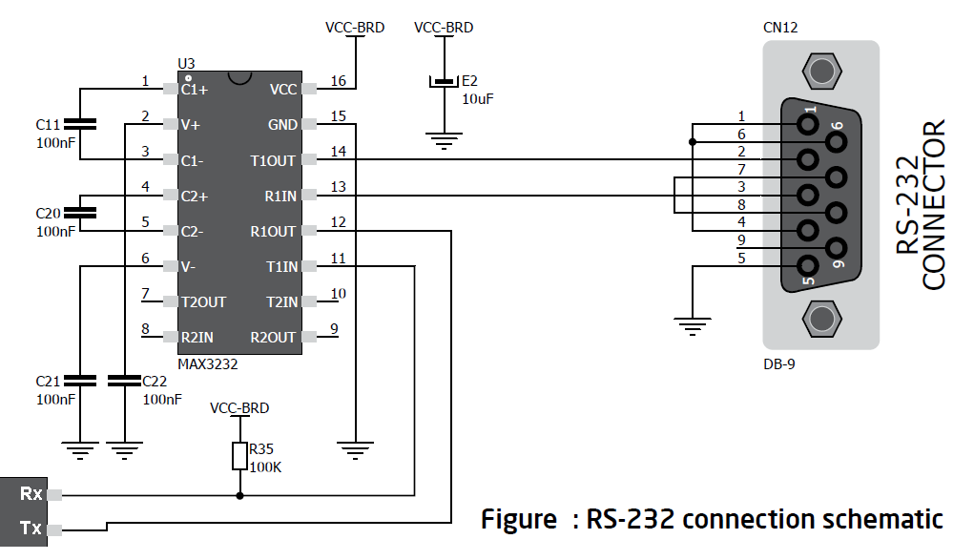
MAX232 Connection Diagram

Slide 13
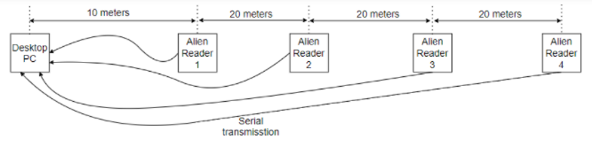
MAX232 Connection Diagram

Slide 14
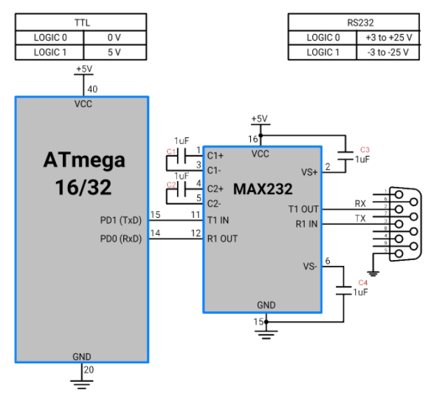
MAX232 Connection Diagram

Slide 15
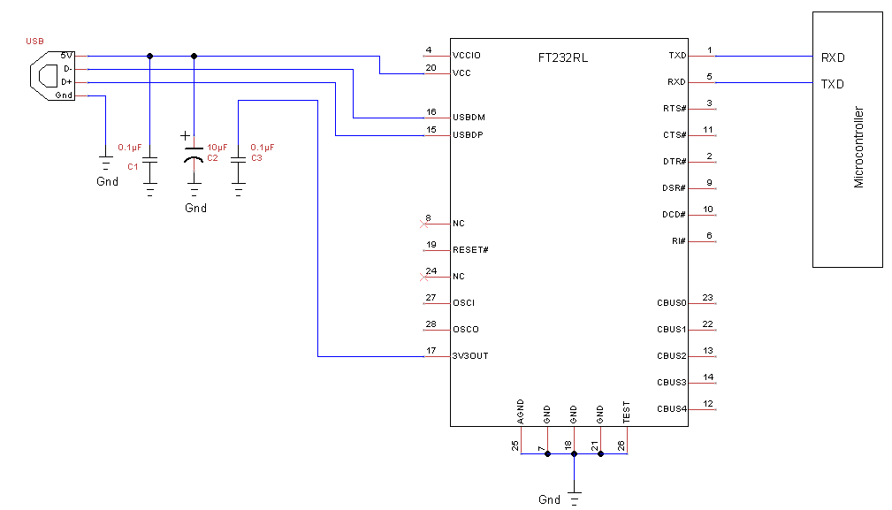
FT232 Connection Diagram

